Slide 1

MINI PROJECT 2020-21 (15ECSW301) Multimodal Hateful Meme Detection.
Team : E5.
Guide : Dr P.G. Sunita Hiremath.
TEAM Members:
* Varun Bohara. 01fe18bcs278
* Sakshi Tahlani. 01fe18bcs271
* Abhishek Rao. 01fe18bcs297
* Madhurika Ganiger. 01fe18bcs284

Slide 2
Outline
INTRODUCTION AND MOTIVATION
PROBLEM STATEMENT
OBJECTIVES
LITERATURE SURVEY
PROPOSED METHODOLOGY
REQUIREMENT ANALYSIS
REFERENCES

Slide 3

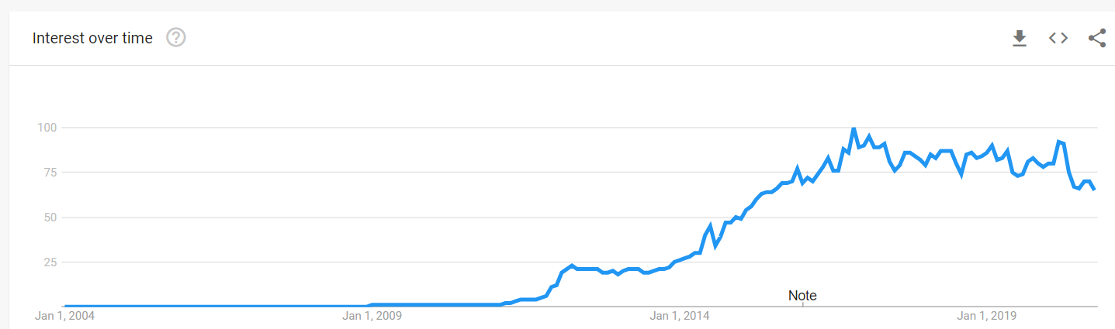
Introduction and Motivation
A meme is an idea, behavior, or style that becomes a trend and spreads by means of imitation from person to person within a culture and often carries symbolic meaning representing a particular phenomenon or theme.
Rise of memes :

Slide 4
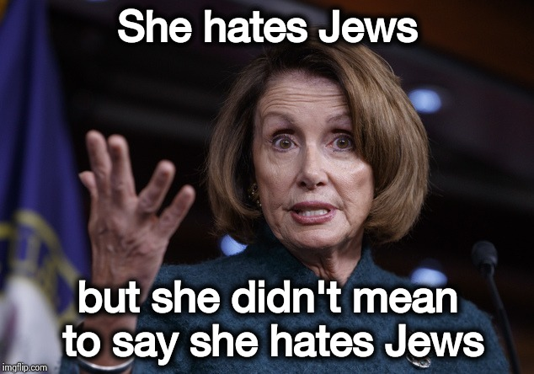
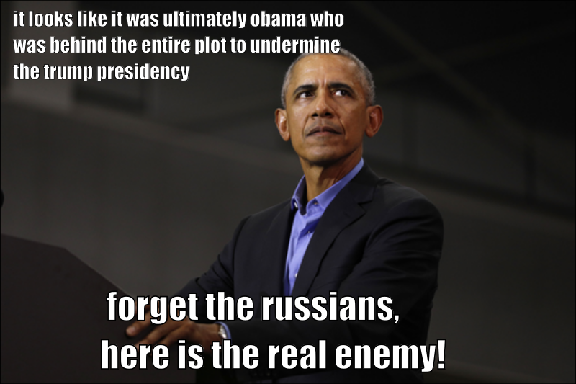
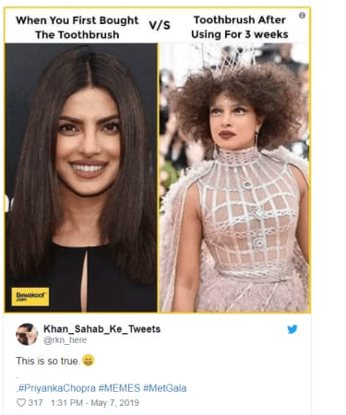

Slide 5
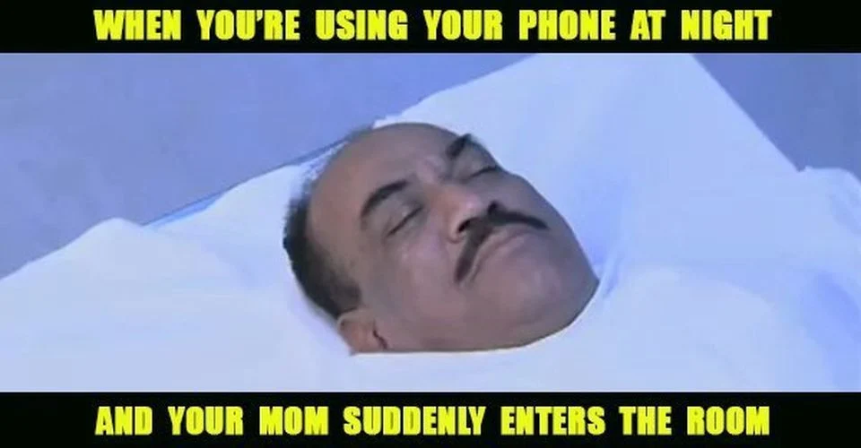
Problem Statement
To develop multimodal architecture which classifies the memes as hateful or non hateful.
Multimodal Architecture
Non Hateful
Output
Input

Slide 6
Objectives
To generate embeddings of image and text .
To fuse the text and image embeddings and build a classifier.
To evaluate the performance of the multimodal architecture.
To compare proposed architecture with state-of-art technique.

Slide 7
Literature Survey

Slide 8
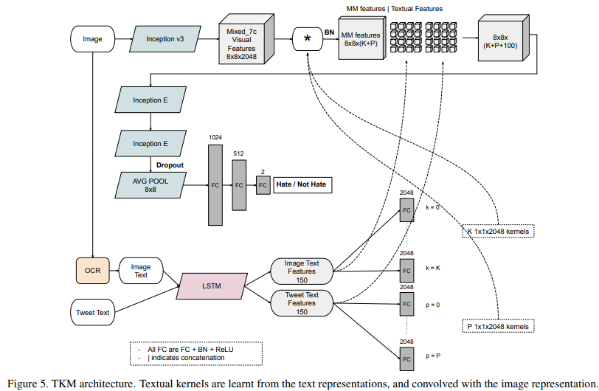
Exploring Hate Speech Detection in Multimodal Publications ( WACV, 2020) [1]
TKM( Textual Kernels Model ):
Inception Model
LSTM Model
Kernel

Slide 9
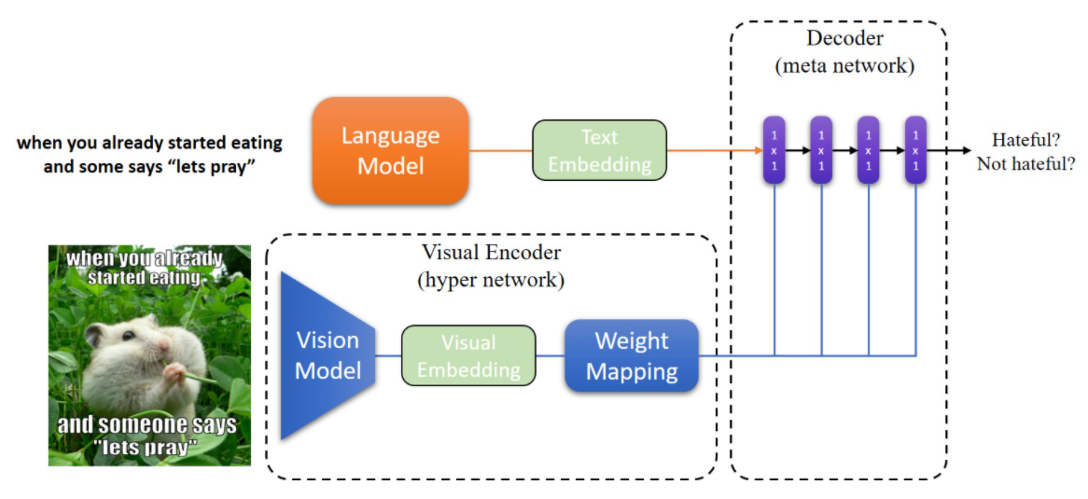
Hateful Memes Challenge 2020, SEP 22 Yuval Nirkin Assaf Rabinowitz Yoni Solel [2]
Data Processing
Text embedding :SBERT
Image Embedding: MobileNetV2
Hypernetworks
Decoder
Varun Bohara

Slide 10
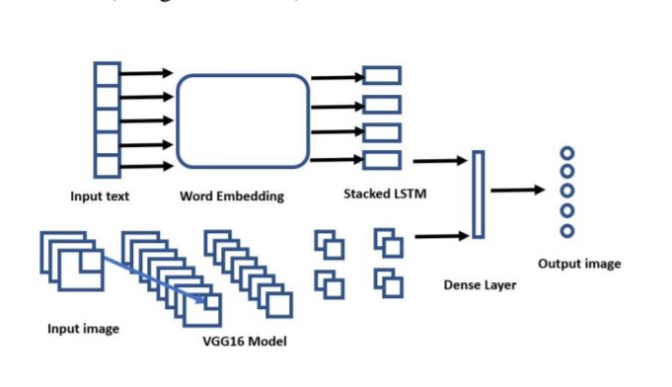
Multimodal Meme Dataset (MultiOFF) for Identifying Offensive Content in Image and Text [3] Shardul Suryawanshi, Bharathi Raja Chakravarthi, Mihael Arcan, Paul Buitelaar
Text Embedding : LSTM
Image Embedding : VGG16
Early Fusion Method

Slide 11

Proposed Methodology
Input
look! a blow up doll
Text Module (Sbert)
Decoder
Performance Evaluation
Visual Module (Inception v3)
Output
Hateful/Non-Hateful

Slide 12
Requirement Analysis
Functional
The system shall be able to generate image and text representations .
The system shall be able to classify the meme as hateful or non hateful using provided embeddings .
The system shall be able to generate the probability of the meme being hateful .
The system shall be comparable to the state of the art techniques.
Non Functional
The system should be atleast 70% accurate .
The system should not under-perform on limited computing resources.
In building the system , the framework used should be Keras,on Linux platform.

Slide 13
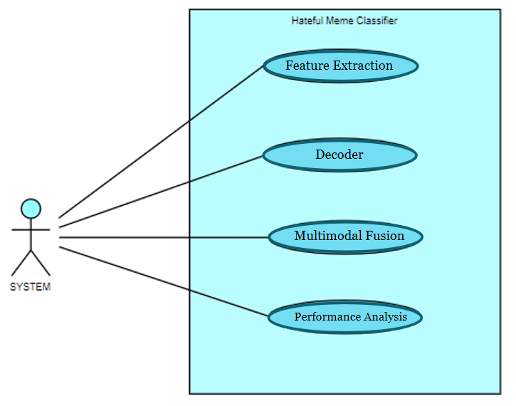
Use Case Diagram

Slide 14
References
[1] Raul Gomez, Jaume Gibert, Lluis Gomez,Dimosthenis Karatzas : Exploring Hate Speech Detection in Multimodal Publications,WACV,2020
[2] Hateful Memes Challenge,Yuval Nirkin, Assaf Rabinowitz ,Yoni Solel,2020, Sep 22 https://nirkin.com/hateful-memes/
[3] Shardul Suryawanshi, Bharathi Raja Chakravarthi,Mihael Arcan, Paul Buitelaar : Multimodal Meme Dataset (MultiOFF) for Identifying Offensive Content in Image and Text,2020.

Slide 15
THANK YOU

